Slide 1
NATURAL LANGUAGE PROCESSING

Slide 2
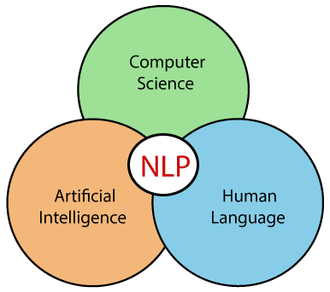
What is NLP?
NLP stands for Natural Language Processing, which is a part of Computer Science, Human language, and Artificial Intelligence. It is the technology that is used by machines to understand, analyse, manipulate, and interpret human's languages. It helps developers to organize knowledge for performing tasks such as translation, automatic summarization, Named Entity Recognition (NER), speech recognition, relationship extraction, and topic segmentation.

Slide 3
Now, modern NLP consists of various applications, like speech recognition, machine translation, and machine text reading.
When we combine all these applications then it allows the artificial intelligence to gain knowledge of the world.
Let's consider the example of AMAZON ALEXA, using this robot you can ask the question to Alexa, and it will reply to you.
Advantages of NLP:
NLP helps users to ask questions about any subject and get a direct response within seconds.
NLP offers exact answers to the question means it does not offer unnecessary and unwanted information.
NLP helps computers to communicate with humans in their languages.
It is very time efficient.
Most of the companies use NLP to improve the efficiency of documentation processes, accuracy of documentation, and identify the information from large databases.

Slide 4
Disadvantages of NLP:
A list of disadvantages of NLP is given below:
NLP may not show context.
NLP is unpredictable
NLP may require more keystrokes.
NLP is unable to adapt to the new domain, and it has a limited function that's why NLP is built for a single and specific task only.
Components of NLP:
1. Natural Language Understanding (NLU)
Natural Language Understanding (NLU) helps the machine to understand and analyse human language by extracting the metadata from content such as concepts, entities, keywords, emotion, relations, and semantic roles.
NLU mainly used in Business applications to understand the customer's problem in both spoken and written language.
NLU involves the following tasks -
It is used to map the given input into useful representation.
It is used to analyze different aspects of the language.

Slide 5
2. Natural Language Generation (NLG) :
Natural Language Generation (NLG) acts as a translator that converts the computerized data into natural language representation.
It mainly involves Text planning, Sentence planning, and Text Realization.
Difference between NLU and NLG
NLU | NLG
NLU is the process of reading and interpreting language. | NLG is the process of writing or generating language.
It produces non-linguistic outputs from natural language inputs. | It produces constructing natural language outputs from non-linguistic inputs.

Slide 6

Applications of NLP:
1. Question Answering:
Question Answering focuses on building systems that automatically answer the questions asked by humans in a natural language.

Slide 7
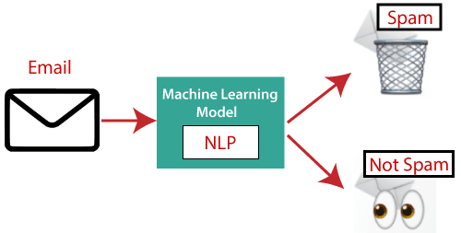
2. Spam Detection:
Spam detection is used to detect unwanted e-mails getting to a user's inbox.

Slide 8

3. Sentiment Analysis :
Sentiment Analysis is also known as opinion mining. It is used on the web to analyse the attitude, behaviour, and emotional state of the sender.
This application is implemented through a combination of NLP (Natural Language Processing) and statistics by assigning the values to the text (positive, negative, or natural), identify the mood of the context (happy, sad, angry, etc.)

Slide 9
4. Machine Translation:
Machine translation is used to translate text or speech from one natural language to another natural language.
Example: Google Translator
5. Spelling correction:
Microsoft Corporation provides word processor software like MS-word, PowerPoint for the spelling correction.
6. Speech Recognition
Speech recognition is used for converting spoken words into text.
It is used in applications, such as mobile, home automation, video recovery, dictating to Microsoft Word, voice biometrics, voice user interface, and so on.

Slide 10
8. Information extraction:
Information extraction is one of the most important applications of NLP.
It is used for extracting structured information from unstructured or semi-structured machine-readable documents.
9. Natural Language Understanding (NLU):
It converts a large set of text into more formal representations such as first-order logic structures that are easier for the computer programs to manipulate notations of the natural language processing.

Slide 11
How to build an NLP pipeline:
There are the following steps to build an NLP pipeline
Step1: Sentence Segmentation
Sentence Segment is the first step for building the NLP pipeline. It breaks the paragraph into separate sentences.
Example: Consider the following paragraph -
Independence Day is one of the important festivals for every Indian citizen. It is celebrated on the 15th of August each year ever since India got independence from the British rule. The day celebrates independence in the true sense.
Sentence Segment produces the following result:
"Independence Day is one of the important festivals for every Indian citizen."
"It is celebrated on the 15th of August each year ever since India got independence from the British rule."
"This day celebrates independence in the true sense.“
Step2: Word Tokenization
Word Tokenizer is used to break the sentence into separate words or tokens.
Example:
Company offers Corporate Training, Summer Training, Online Training, and Winter Training.
Word Tokenizer generates the following result:
“Company", "offers", "Corporate", "Training", "Summer", "Training", "Online", "Training", "and", "Winter", "Training", "."

Slide 12
Step3: Stemming
Stemming is used to normalize words into its base form or root form. For example, celebrates, celebrated and celebrating, all these words are originated with a single root word "celebrate." The big problem with stemming is that sometimes it produces the root word which may not have any meaning.
For Example, intelligence, intelligent, and intelligently, all these words are originated with a single root word "intelligen." In English, the word "intelligen" do not have any meaning.
Step 4: Lemmatization
Lemmatization is quite similar to the Stamming. It is used to group different inflected forms of the word, called Lemma. The main difference between Stemming and lemmatization is that it produces the root word, which has a meaning.
For example: In lemmatization, the words intelligence, intelligent, and intelligently has a root word intelligent, which has a meaning.
Step 5: Identifying Stop Words
In English, there are a lot of words that appear very frequently like "is", "and", "the", and "a". NLP pipelines will flag these words as stop words. Stop words might be filtered out before doing any statistical analysis.
Example: He is a good boy.
Note: When you are building a rock band search engine, then you do not ignore the word "The."

Slide 13
Step 6: Dependency Parsing
Dependency Parsing is used to find that how all the words in the sentence are related to each other.
Step 7: POS tags
POS stands for parts of speech, which includes Noun, verb, adverb, and Adjective. It indicates that how a word functions with its meaning as well as grammatically within the sentences. A word has one or more parts of speech based on the context in which it is used.
Example: "Google" something on the Internet.
In the above example, Google is used as a verb, although it is a proper noun.
Step 8: Named Entity Recognition (NER)
Named Entity Recognition (NER) is the process of detecting the named entity such as person name, movie name, organization name, or location.
Example: Steve Jobs introduced iPhone at the Macworld Conference in San Francisco, California.
Step 9: Chunking
Chunking is used to collect the individual piece of information and grouping them into bigger pieces of sentences.

Slide 14
NLP Libraries :
Scikit-learn: It provides a wide range of algorithms for building machine learning models in Python.
Natural language Toolkit (NLTK): NLTK is a complete toolkit for all NLP techniques.
Pattern: It is a web mining module for NLP and machine learning.
TextBlob: It provides an easy interface to learn basic NLP tasks like sentiment analysis, noun phrase extraction, or pos-tagging.
Quepy: Quepy is used to transform natural language questions into queries in a database query language.
SpaCy: SpaCy is an open-source NLP library which is used for Data Extraction, Data Analysis, Sentiment Analysis, and Text Summarization.
Gensim: Gensim works with large datasets and processes data streams.

Slide 15
How to identify Spam using Natural Language Processing (NLP)?

Slide 16
Email Spam Detection using Natural Language Processing with Python
Humans master millions of words, but computationally speaking: how can we manipulate large amounts of text using programming techniques?
This will focus on how computer systems can analyze and interpret texts, using the Natural Language Processing (NLP). For that, you should install Natural Language Toolkit, you can do it from http://nltk.org. Instructions are available on the cited website along with details of associated packages that need to be installed as well, including Python itself, which is also freely available.

Slide 17
LANGUAGE PROCCESS IN PYTHON:
The purpose of this case study is to show you how to detect spam in SMS.
For that, we use a dataset from the UCI datasets, which is a public set that contain SMS labelled messages that have been collected for mobile phone spam research. It has one collection composed by 5.574 SMS phone messages in English, tagged according being legitimate (ham) or spam.
Therefore, we will train a model to learn to automatically discriminate between ham / spam. Then we will use “test data” to test the model. Finally to evaluate if our model is efficient, we will calculate Accuracy, Classification report and Confusion Matrix.

Slide 18
Exploratory Data Analysis:
# Import library
import pandas as pd
import numpy as np
import string
import seaborn as sns
import matplotlib.pyplot as plt
from nltk.corpus import stopwords
from sklearn.feature_extraction.text import CountVectorizer
from sklearn.feature_extraction.text import TfidfTransformer
from sklearn.model_selection import train_test_split
from sklearn.svm import SVC
from collections import Counter
from sklearn.metrics import classification_report,confusion_matrix
from sklearn.model_selection import GridSearchCV
%matplotlib inline
# Load data
data = pd.read_excel('data.xlsx')
# Rename names columns
data.columns = ['label', 'messages']

Slide 19
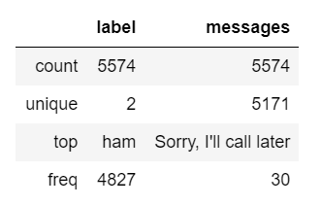
Let’s see a description of our data:
data.describe()
Note : That our data contains a collection of 5574 SMS and also we have only 2 label: ham and spam. Now, we create a column called ‘length’ to know how long the text messages are and then plot it against the label

Slide 20
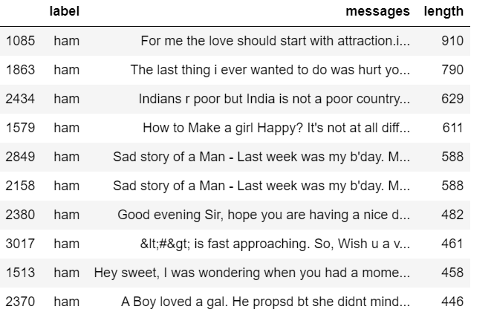
data["length"] = data["messages"].apply(len) data.sort_values(by='length', ascending=False).head(10)

Slide 21
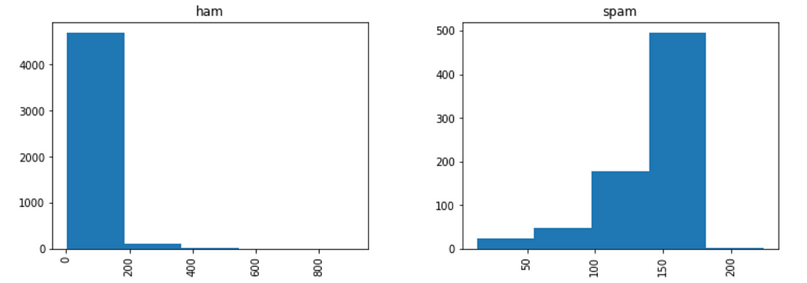
data.hist(column = 'length', by ='label',figsize=(12,4), bins = 5)
Note that through the histogram, we have been able to discover that spam messages tend to have more characters

Slide 22
INTERPRETATION :
Most likely, most of the data you have come across is numeric or categorical, but what happens when it is of type string (text format)?
As you may have noticed, our data is of type string. Therefore, we should transform it into a numeric vector to be able to perform the classification task. To do this, we use bag-of-words where each unique word in a text will be represented by a number. However, before doing this transformation, we should remove all punctuations and then common words like
[‘I’, ‘my’, ‘myself’, ‘we’, ‘our’, ‘our’ , ‘ourselves’, ‘you’, ‘are’ …]. This process is called tokenization.
After this process, we convert our string sequence into number sequences.
Remove all punctuation: Suppose we have the following sentence: **********Hi everyone!!! it is a pleasure to meet you.**********
and we want to remove !!!

Slide 23
1. First, we load the import string library and do the following:
message = "Hi everyone!!! it is a pleasure to meet you."
message_not_punc = []
for punctuation in message:
if punctuation not in string.punctuation:
message_not_punc.append(punctuation)
# Join the characters again to form the string.
message_not_punc = ''.join(message_not_punc)
print(message_not_punc)
Output:
>>> Hi everyone it is a pleasure to meet you

Slide 24
2. Remove common words:
To do that, we use the library nltk, i.e, from nltk.corpus import stopwords
Is important to know that stopwords have 23 languages supported by it (this number must be up to date). In this case, we use English language:
from nltk.corpus import stopwords
# Remove any stopwords for remove_punc, but first we should to transform this into the list.
message_clean = list(message_not_punc.split(" "))
# Remove any stopwords
i = 0
while i <= len(message_clean):
for mess in message_clean:
if mess.lower() in stopwords.words(‘english’):
message_clean.remove(mess)
i =i +1
print(message_clean)
>>> ['Hi', 'everyone', 'pleasure', 'meet']

Slide 25
Thus, with the steps 1 and 2, we can create the following function:
def transform_message(message):
message_not_punc = [] # Message without punctuation
i = 0
for punctuation in message:
if punctuation not in string.punctuation:
message_not_punc.append(punctuation)
# Join words again to form the string.
message_not_punc = ''.join(message_not_punc)
# Remove any stopwords for message_not_punc, but first we should transform this into the list
message_clean = list(message_not_punc.split(" "))
while i <= len(message_clean):
for mess in message_clean:
if mess.lower() in stopwords.words('english'):
message_clean.remove(mess)
i =i +1
return message_clean

Slide 26
Now we can apply the Function to our Data Analysis in the following ways:
data['messages'].head(5).apply(transform_message)
Output:
0 [Go, jurong, point, crazy, Available, bugis, n...
1 [Ok, lar, Joking, wif, u, oni]
2 [Free, entry, 2, wkly, comp, win, FA, Cup, fin...
3 [U, dun, say, early, hor, U, c, already, say]
4 [Nah, dont, think, goes, usf, lives, around, t...
Name: messages, dtype: object

Slide 27
Vectorization :
Note that, we have the messages as lists of tokens. So, the next step is to convert each of those messages into a vector.
To do that, we use CountVectorizer from Scikit Learn. CountVectorizer converts a collection of documents to an array of token counts.
First all of, we import CountVectorizer from sklearn learn:
from sklearn.feature_extraction.text import CountVectorizer
CountVectorizer has many parameters, but we only use “analyzer”, which is our own previously defined function:
vectorization = CountVectorizer(analyzer = transform_message )
X = vectorization.fit(data['messages'])

Slide 28
X_transform = X.transform([data['messages']])
print(X_transform)
Output:
(0, 11383) 9
(0, 11384) 20
(0, 11385) 14
(0, 11386) 2
(0, 11387) 4
(0, 11391) 11
(0, 11393) 5
(0, 11396) 1
(0, 11397) 1
(0, 11398) 18
(0, 11399) 18
(0, 11405) 2
(0, 11408) 1
(0, 11410) 1
(0, 11411) 8
(0, 11412) 7
(0, 11413) 1

Slide 29
TF-IDF:
After applying “CountVectorizer” on our data, we use TF-IDF. Surely, you are wondering what is TD-FT? and why should we use it? Let me explain you:
TF-IDF is the abbreviation of Inverse document frequency is a numerical measure that expresses how relevant a word is to a document in a collection.
The value of TF-IDF increases proportionally to the number of times a word appears in the document, and is offset by the frequency of the word in the document collection, which allows handling of the fact that some words are generally more common than others.

Slide 30
How to Compute TF-IDF ?
TF-IDF is composed by two terms: the first term is the Term Frequency (TF) and the second is the Inverse Document Frequency (IDF).
Term Frequency (TF): Which measures how frequently a term occurs in a document, that is, the number of times a word appears in a document, divided by the total number of words in that document
TF(t) = (Number of times term t appears in a document) / (Total number of terms in the document)
Inverse Document Frequency (IDF): Measures how important a term is, computed as the logarithm of the number of the documents in the corpus divided by the number of documents where the specific term appears.
IDF(t) = log_e(Total number of documents / Number of documents with term t in it)

Slide 31
Continuing with our code, we import TfidfVectorizer from sklearn.feature_extraction.text :
tfidf_transformer = TfidfTransformer().fit(X_transform)
To transform the entire bag-of-words corpus into TF-IDF corpus at once:
X_tfidf = tfidf_transformer.transform(X_transform)
print(X_tfidf.shape)
Output:
>>> (5572, 11425)
Classification Model:
Having the features represented as vectors, we can finally train our spam/ham classifier. You can use any classification algorithms . Here we use Support Vector Classification (SVC) algortihm.
First, we split the data into train and test data. We take 80 % (0.80) training data and 30% (0.30) test data and the we fit the model using SVC:
X_train, X_test, y_train, y_test = train_test_split(X_tfidf, data['messages'], test_size=0.30, random_state = 50) clf = SVC(kernel='linear').fit(X_train, y_train)

Slide 32
Test model :
To test the model we use X_test previously calculated:
predictions = clf.predict(X_test)
print('predicted', predictions)
>>> predicted ['spam' 'ham' 'ham' ... 'ham' 'ham' 'spam’]
Is our model reliable?
The question that arises is, our model reliable across the entire data set?
For that, we can use SciKit Learn’s built-in classification report, which returns Precision, Recall, F1-Score and also Confusion Matrix

Slide 33
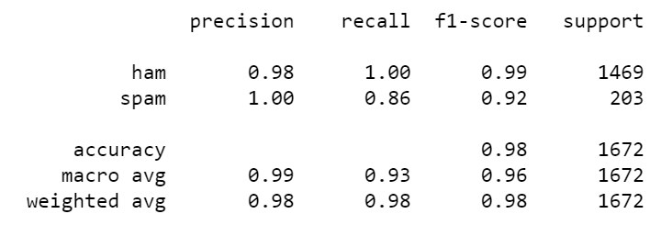
from sklearn.metrics import classification_report
print (classification_report(y_test, predictions))

Slide 34

from sklearn.metrics import confusion_matrix
print(confusion_matrix(y_test,predictions))
The accuracy is a good way to know is the model is efficient but this is not enough to say that our model is good, for this reason we have used Classification Report and Confusion Matrix. You can see that results obtained are quite good.

Slide 35
THE END

